Slide 1
B. TECH PROJECT
(COE – 415)
Submitted By :
KSHITIJ RAJPUT 276/CO/15
RAGHAV KAPOOR 322/CO/15
Guided by :
Mrs. PREETI KAUR
(Professor, NSUT)

Slide 2

DVESH PRAHARI :
ATTACKERS IN DISGUISE
Detecting Vindictive Behavior from Social Media during elections in Code-Switched Languages Using NLP and Vision Techniques

Slide 3
AIM
We aim to undertake a total of four individual tasks in order to achieve the final goal of labelling the pages and users on facebook and twitter which spring up during the election times.
Through the help of the proposed system, we would now be able to figure out the pages and users that misleadingly take part in the campaigns and create a fraudulent environment and misuse the freedom of speech.
These comprise of :-
Creation of a suitable model and embeddings
Enhancing NLP Word2vec model
Deducing hate speech for images
Applying the work to various social media platforms

Slide 4
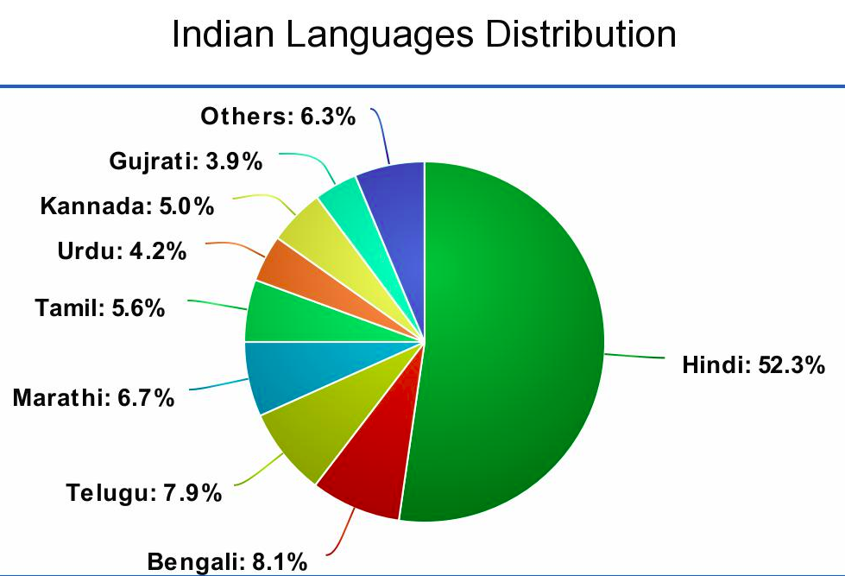
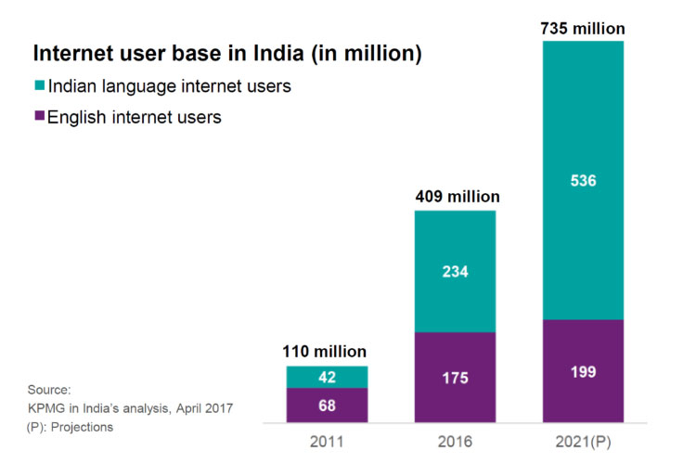
CURRENT SCENARIO
In multilingual societies (Eg: India), code-switched language(Hinglish) is most popular
Indian Internet Users crossed 500 million in 2018.
Tackles the difficulty of non-fixed grammar, vocabulary and semantics of the language pair.

Slide 5


SCOPE OF WORK
Detect False Propaganda by Political Groups in Elections
Youtube/ Netflix Subtitles – “Auto-beep” offensive language
Online Social Media - Report Defamatory Pages and comments
Feedback analytics for better user experience.
Real time “clean-chat” facility.
Censor board – Auto-eliminate abusive content.

Slide 6
INTRODUCTION
Natural Language processing (NLP) is the analysis that explores how computers
perceive and manipulate
language
Hate speech is a statement intended to demean and brutalize another or the use of derogatory language
Mixed used of more than 2 languages in a text is called as code switching
For eg : Hindi-English (Hinglish)
Multimodality describes communication practices in terms of the textual, aural, linguistic, spatial, and visual resources

Slide 7
RELATED WORK
Sentiment Analysis
The task of sentiment analysis on code mixed Hi-En (Hinglish) social media content was first performed by Joshi et al. (2016) who used sub-word level representations in LSTM architecture to categorize tweets in positive, negative or neutral category.
Jhanwar et al. (2018) proposed an ensemble method for sentiment analysis on Hindi-English code switched dataset which outperformed the previous models of sentiment analysis.
Another method put forward by Gupta et al. (2018) performed the task of sentiment analysis on code switched Hinglish tweets dataset using a CNN based model consisting of a sentence representation matrix, convolution layer, pooling layer and fully connected layer

Slide 8
RELATED WORK
Hate Speech Detection
The initial task for hate speech detection was performed by Spertus et al. (1997), who developed a prototype system Smokey for detecting email flames (angry or offensive emails) using a 47 elements feature set which captured the syntax and semantics of the sentences present in the dataset.
The task of hate speech detection on Italian language using the following features: (i) morpho-syntactical features, (ii) sentiment polarity and (iii) word embedding lexicons was shown by Del Vigna (2017).
The task of hate speech detection on Hindi-English code switched data using a Random Forest (RF) classifier and a Support Vector Machine (SVM) classifier was performed by Bohra et al. (2018) using a 4 element feature set extracted from the tweets.
A ternary trans CNN model using transfer learning for hate speech detection on Hindi-English code switched dataset was proposed by Mathur et al. (2018).

Slide 9
RELATED WORK
Image Analysis
Research by Wang et al. (2006) focused on analyzing sentiment out of images by proposing a mechanism for finding the emotion out of an image by finding a orthogonal three dimensional factor space of a image and then passing it through a SVM classifier.
Siersdorfer et al. (2010) analyzed the relation between sentiment of images expressed in metadata and their visual content in the social photo sharing environment Flickr.
A progressive CNN model for visual sentiment analysis with transfer learning to learn the features on a twitter image dataset was also proposed by You et al. (2015).
Cai et al. (2017) performed sentiment analysis on the combination of text and images instead of considering them separately using two individual CNN architectures and them combining the results from both the architectures to calculate the final sentiment of the image.

Slide 10
CLASSIFICATION OF TWEETS

Slide 11

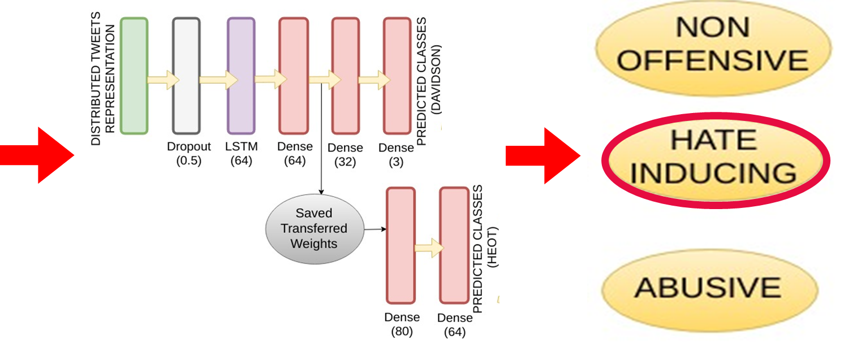
WORKFLOW FOR TWEETS/ COMMENTS
ham unhe barbaad kar denge
हम उन्हें बर्बाद
कर देंगे
we will
destroy
them
( Indic-transliteration
python library )
( Xlit Crowd Conversion Dictionary )
Comments from Social Media
Comments in Hindi
Trans-literation to English
Translation to English
Passes through our system
Highly Accurate Results

Slide 12
PREPROCESSING AND DATASET
Dataset
HEOT
Pre-
processing
Xlit Crowd conversion dictionary
Corpus
Liepzig Hindi Corpus
Embedding
FastText
Davidson
Indic-transliterate
Hindi Profanity List
Word2Vec
GloVe

Slide 13
MODEL - LSTM
DISTRIBUTED TWEETS
REPRESENTATION
Hate Inducing
Transfer Learning
To utilize the benefits from weights trained before.
Non Offensive
Abusive
Hate Inducing
Dropout
(0.5)
LSTM
(64)
Dense
(64)
Dense
(32)
Dense
(3)
Saved Weights
Non Offensive
Ternary classification model
LSTM
Based Model
Abusive
Dense
(80)
Dense
(64)

Slide 14
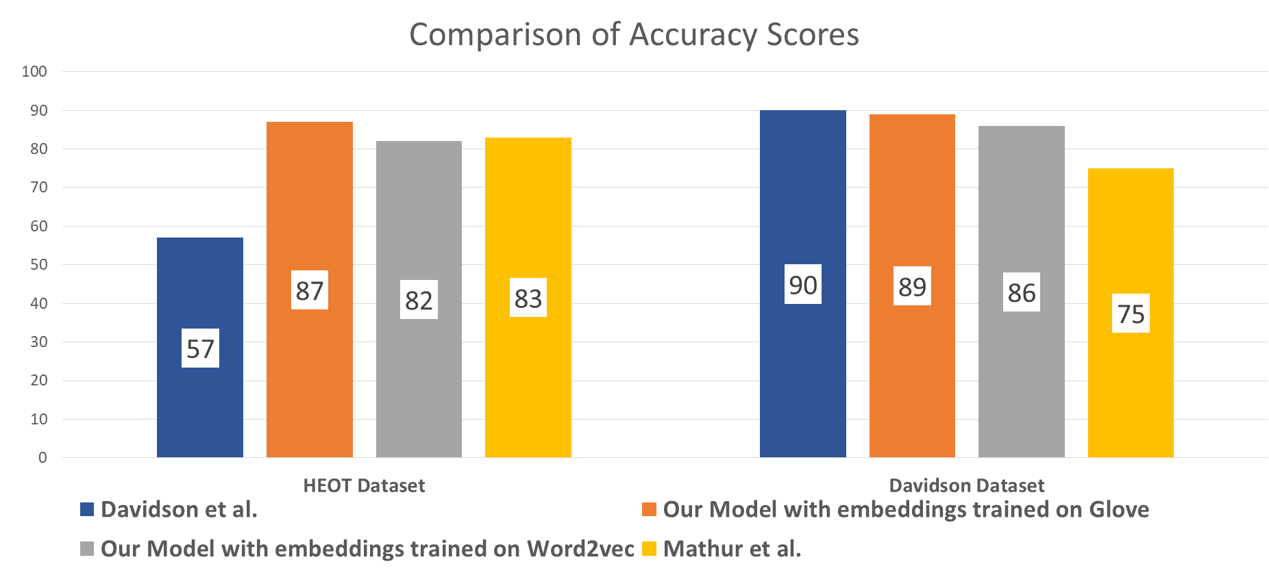



TWEETS CLASSIFICATION RESULTS
Accuracy, F1, Precision, Recall are used as metrics to evaluate the credibility of results.
Best results for our model trained on Glove embeddings on HEOT dataset.
Comparable results on Davidson English tweets dataset.
State of the art results
for Hinglish language.
$$Precision=\frac{True Positive }{True Positive+False Positive}$$
Recall $=\frac{True Positive }{True Positive+False Negative}$
F$1=2∗\frac{\text{Precision}\text{ ∗ }\text{Recall} }{\text{Precision}\text{ + }\text{Recall}}$

Slide 15

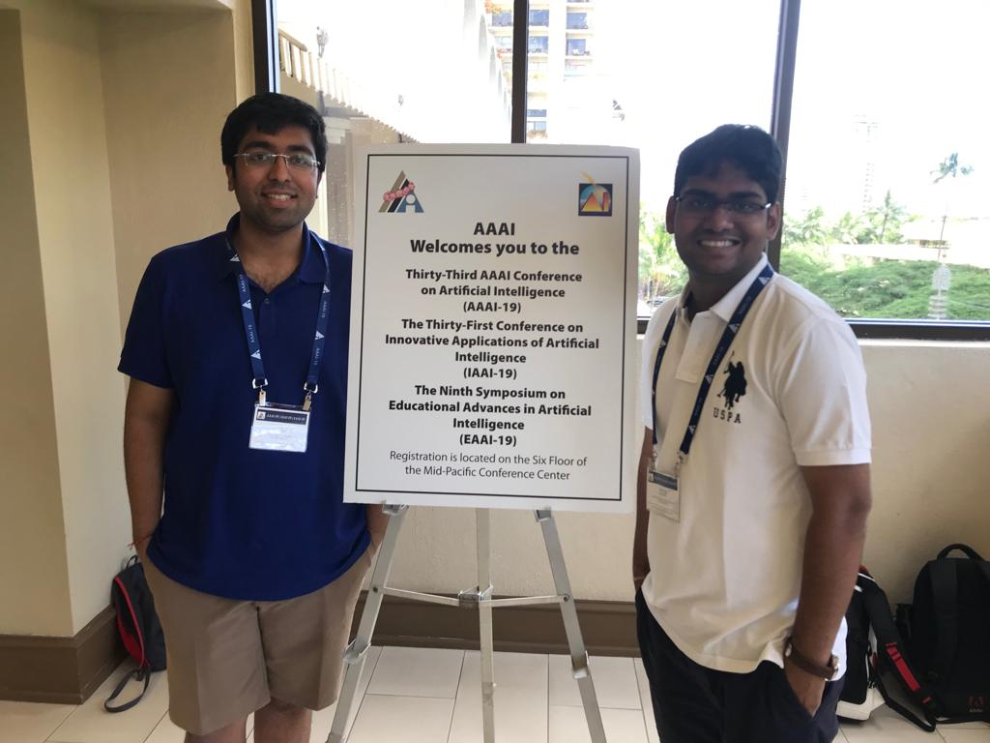
MILESTONES ACHIEVED….
****** PUBLISHED IN PROCEEDINGS OF AAAI – 19, HONOLULU, HAWAII, U.S.A. *******
(Artificial Intelligence, Association for the Advancement of Artificial Intelligence.)
(H-INDEX – 69)
(A* Conference)
******* The Best Poster Award At AAAI-19 *******
****** SCHOLARSHIP FROM AAAI - 19 *******

Slide 16
DEPENDENCY BASED EMBEDDINGS

Slide 17
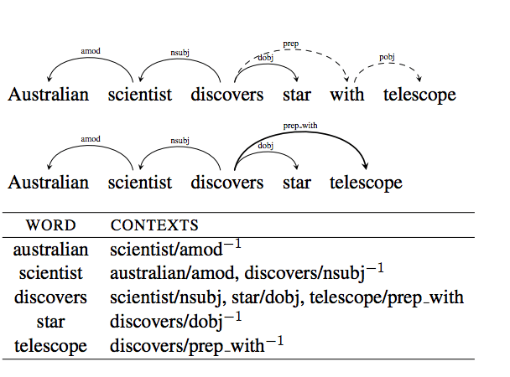
DEPENDENCY BASED EMBEDDINGS
Normal word2vec model considers adjacent words as a part of the context.
Parse Tree generated through dependency parser on ~10GB Hindi Corpus
Parse Tree passed to word2vecf to create unique set of embeddings called “Context Based Embeddings” which no more consider adjacent words
Smart Embeddings produce better results than Vanilla Embeddings
Embedding dimension used was 50, 100, 300, 500
Context window size used was 2,3,5

Slide 18
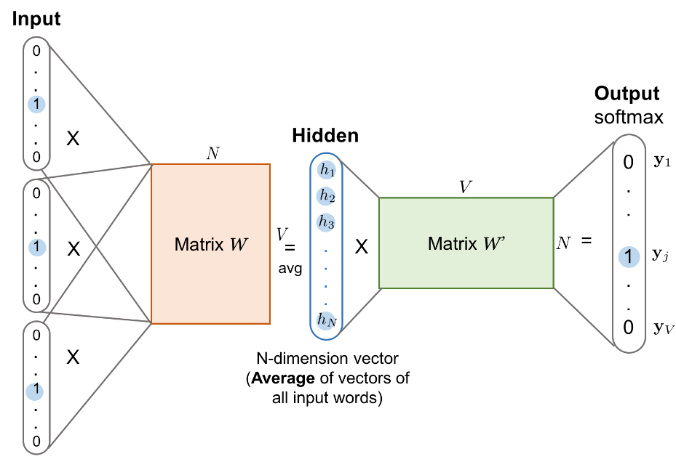
WORD EMBEDDINGS
Word embedding is the name for a set in NLP where words from the vocabulary are mapped to vectors.
These are used to form the first layer of our model.
These embeddings help to learn the distributed representations of tweets by creating word vectors
We have used 3 embeddings for this task :
CBOW Word2Vec
Skip Gram Word2Vec
Dependency based embeddings

Slide 19
DEPENDENCY BASED RESULTS
Dependency based embeddings perform at par than vanilla embeddings on LSTM model on HEOT dataset
Huge rise of 6% in Skip Gram based word2Vec embeddings
Massive shoot up of 7% in CBOW word2Vec embeddings
Embeddings |  |  |  | Accuracy | Precision
Training Algorithm | Window Size | Vector Size | Type
SG | 2 | 100 | Vanilla | 82.56 % | 0.81
SG | 2 | 100 | Dependency | 88.14 % | 0.89
CBOW | 2 | 100 | Vanilla | 79.68 % | 0.80
CBOW | 2 | 100 | Dependency | 86.01 % | 0.88

Slide 20
CLASSIFICATION OF IMAGES
Textual Data
Images
Memes
Recombination

Slide 21

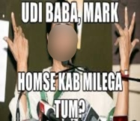
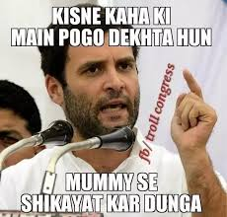
INDIAN POLITICAL MEMES (IPM) DATASET
A dataset of 1218 images which are shared by politically inclined users on social media will be scraped using Google_image_download.
Triply annotated dataset in 3 categories - hate-inducing, benign and satirical content.
This dataset is used for multimodal hate speech classification, i.e., for images / Memes analysis.
Hate-Inducing
Benign
Satirical

Slide 22
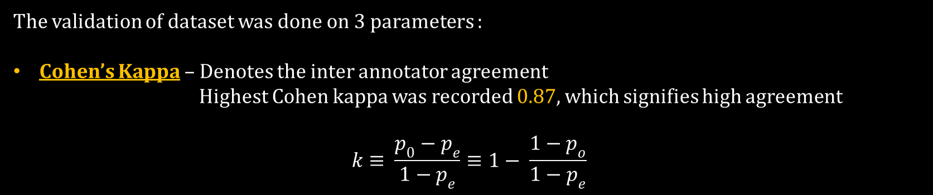
INDIAN POLITICAL MEMES (IPM) DATASET
The validation of dataset was done on 3 parameters :
Cohen’s Kappa – Denotes the inter annotator agreement
Highest Cohen kappa was recorded 0.87, which signifies high agreement
$$k≡ \frac{p_{0}−p_{e}}{1−p_{e}}≡1− \frac{1−p_{o}}{1−p_{e}}$$

Slide 23
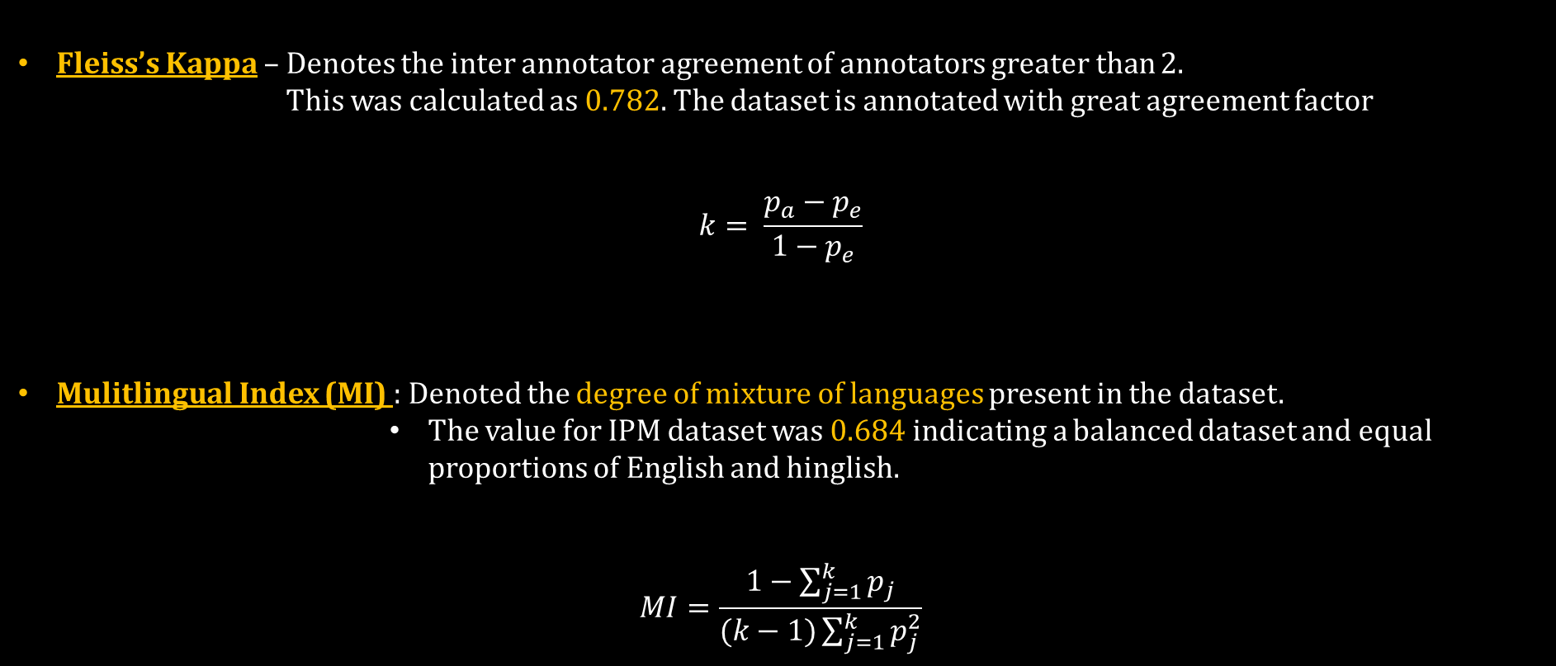
INDIAN POLITICAL MEMES (IPM) DATASET
Fleiss’s Kappa – Denotes the inter annotator agreement of annotators greater than 2. This was calculated as 0.782. The dataset is annotated with great agreement factor
$$k= \frac{p_{a}−p_{e}}{1−p_{e}}$$
Mulitlingual Index (MI) : Denoted the degree of mixture of languages present in the dataset.
The value for IPM dataset was 0.684 indicating a balanced dataset and equal proportions of English and hinglish.
$$MI=\frac{1−\sum_{j=1}^{k}{p_{j}}}{(k−1)\sum_{j=1}^{k}{p_{j}^{2}}}$$

Slide 24
WORKFLOW FOR IMAGES / MEMES
MULTIMODAL HATE SPEECH IDENTIFICATION – Analysis of Text and Images in parallel using binary channel CNN-LSTM based model
Use Text from Image captions
Use CNN-LSTM model for image classification. LSTM for text and CNN for images.
OCR Extraction of text from Images
Recombination of the two channels
Final classification of Memes on IPM dataset

Slide 25
PREPROCESSING IMAGES
Techniques for image preprocessing
Rescaling
Gaussian Blurring
Deskewing
Gaussian Adaptive threshold
The image needs to be pre-processed in order to extract text out of the meme efficiently.
The OCR reader performs some of the image preprocessing
We did some manual preprocessing which includes the following techniques

Slide 26
DATA AUGMENTATION
Data augmentation refers to methods for constructing iterative optimization or sampling algorithms via the introduction of unobserved data or latent variables
The technique of data augmentation is used to increase the size of the dataset to train the classifier model
We have used mainly 5 different techniques of data augmentation :
Scaling
Adding Noise
Flipping
Translation
Rotation

Slide 27
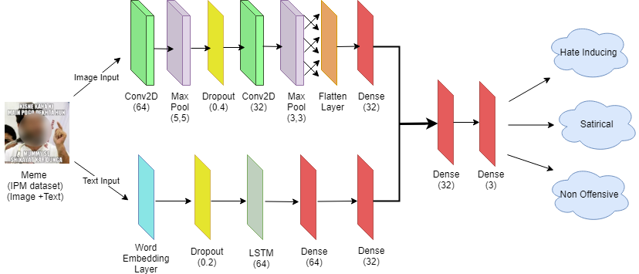
MODEL
CNN for image classification
Ternary classification model
LSTM for text classification

Slide 28
EXPERIMENTATION
Baseline Models
Support Vector Machine (SVM)
Kernel = ‘poly’
Random Forest (RF)
N_estimators = 600
CNN model
LSTM model
Degree = 3
All other hyper parameters are set to default
Max_depth = 12
Max_features = log2
Convolution2D layer of filter size = 64 & kernel size = (5, 5).
Max_pooling layer of pool size = (5, 5).
Dense layer size = 64 and a Dropout layer= 0.4
LSTM layer of size = 64
Adam optimizer and L2 regularization.
Dropout layer = 0.4

Slide 29
EXPERIMENTATION
Features Extracted for input to SVM and RF models
GLCM
Gray-Level Co-occurrence Matrix (GLCM) gives the texture of the image which is useful for determining the emotional expression in an image
Color
Calculated using Earth Mover's Distance (EMD) between the histogram of an image and the histogram having a uniform color distribution
Color can be the means of spreading religious hatred through a meme.
Tamura features
Tamura features capture the texture of an image more effectively.
Human Face
Human face feature is used because two similar images can have different impact on the user depending on the fact that it contains a face or not

Slide 30
MEMES CLASSIFICATION RESULTS
State of the art results for Image Classification on IPM dataset
Features | Precision | Recall | F1-Score
Glove(Gl) | 0.812 | 0.816 | 0.822
Twitter Word2Vec(Tw) | 0.781 | 0.786 | 0.781
FastText(Ft) | 0.791 | 0.784 | 0.793
Bert(Bt) | 0.758 | 0.804 | 0.784
(Gl) + (Tw) | 0.727 | 0.751 | 0.722
(Gl) + (Ft) | 0.803 | 0.811 | 0.810
(Bt) + (Tw) | 0.788 | 0.780 | 0.772
(Gl) + (Ft) | 0.779 | 0.790 | 0.765
(Bt) + (Ft) | 0.780 | 0.783 | 0.796
We use CNN – LSTM based model with different flavours of embeddings : Word2Vec, Glove, Fastext, Bert
Comparison with other models :
SVM – 19%
RF – 23%
CNN – 17%
LSTM – 22%

Slide 31
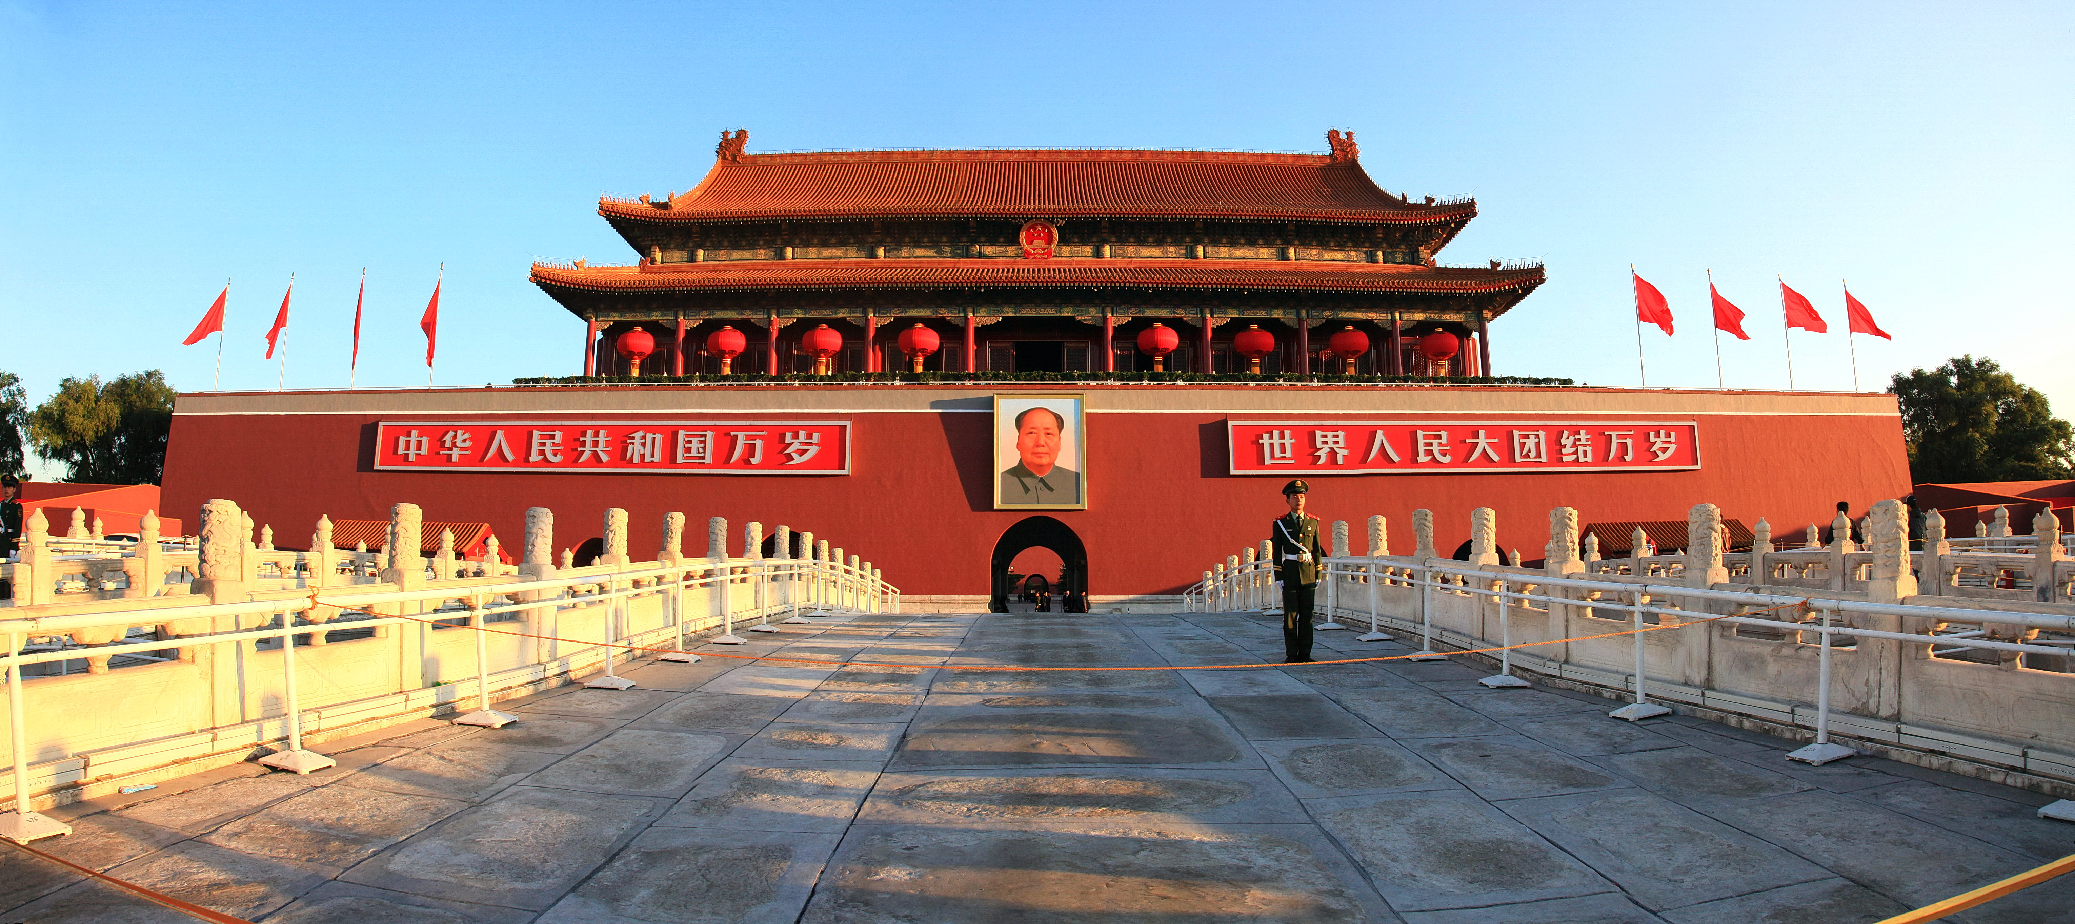

MILESTONES ACHIEVED….
****** ANOTHER PAPER SUBMITTED IN
28TH ACM CONFERENCE ON INFORMATION RETRIEVAL AND KNOWLEDGE MANAGEMENT
BEIJIING, CHINA ******
***** PAPER TITLE - HATE ME NOT : DETECTING HATE INDUCING MEMES IN CODE SWITCHED
LANGUAGES *****
****** A+ CONFERENCE WITH H-INDEX – 42 *******

Slide 32
APPLICATION ON SOCIAL MEDIA

Slide 33
WORKFLOW MODEL
Scrape Tweets from twitter handle using Twitter API
Scrape Images from Twitter handle by using twitter-photos python package
Preprocess and classify tweets using the LSTM model
Process and Classify images using CNN-LSTM memes model
Plotted Graphs using matplotlib to analyse the pages and twitter handles

Slide 34
RESULTS - @theskindoctor13
We extracted 1000 tweets and 200 images from twitter handle - @theskindoctor13
48.5 % Memes are Hate inducing and 64.3 % Tweets are Hate Inducing
Suggesting the page is hate inducing and must be removed fro Twitter

Slide 35
Conclusion
Prevent vindictive behaviour on social media
Curb misuse of freedom of speech online
Proposed a LSTM based model for textual data.
Identify pages and users that spread false propaganda online.
Used dependency based embeddings to improve results
Created a Indian Political Memes Dataset(IPMD)
Multimodal hate and abusive speech detection

Slide 36






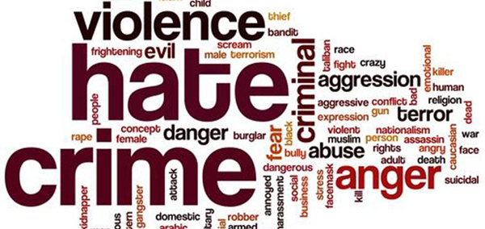




APPLICATIONS
Use by whatsapp, messenger to remove bad words
Online Social Media - Report Defamatory Pages and comments
Video streaming applications use for abuse free subtitles
User Feedback on various platforms to analyse sentiments of users
Election Commission use for detecting false propaganda

Slide 37
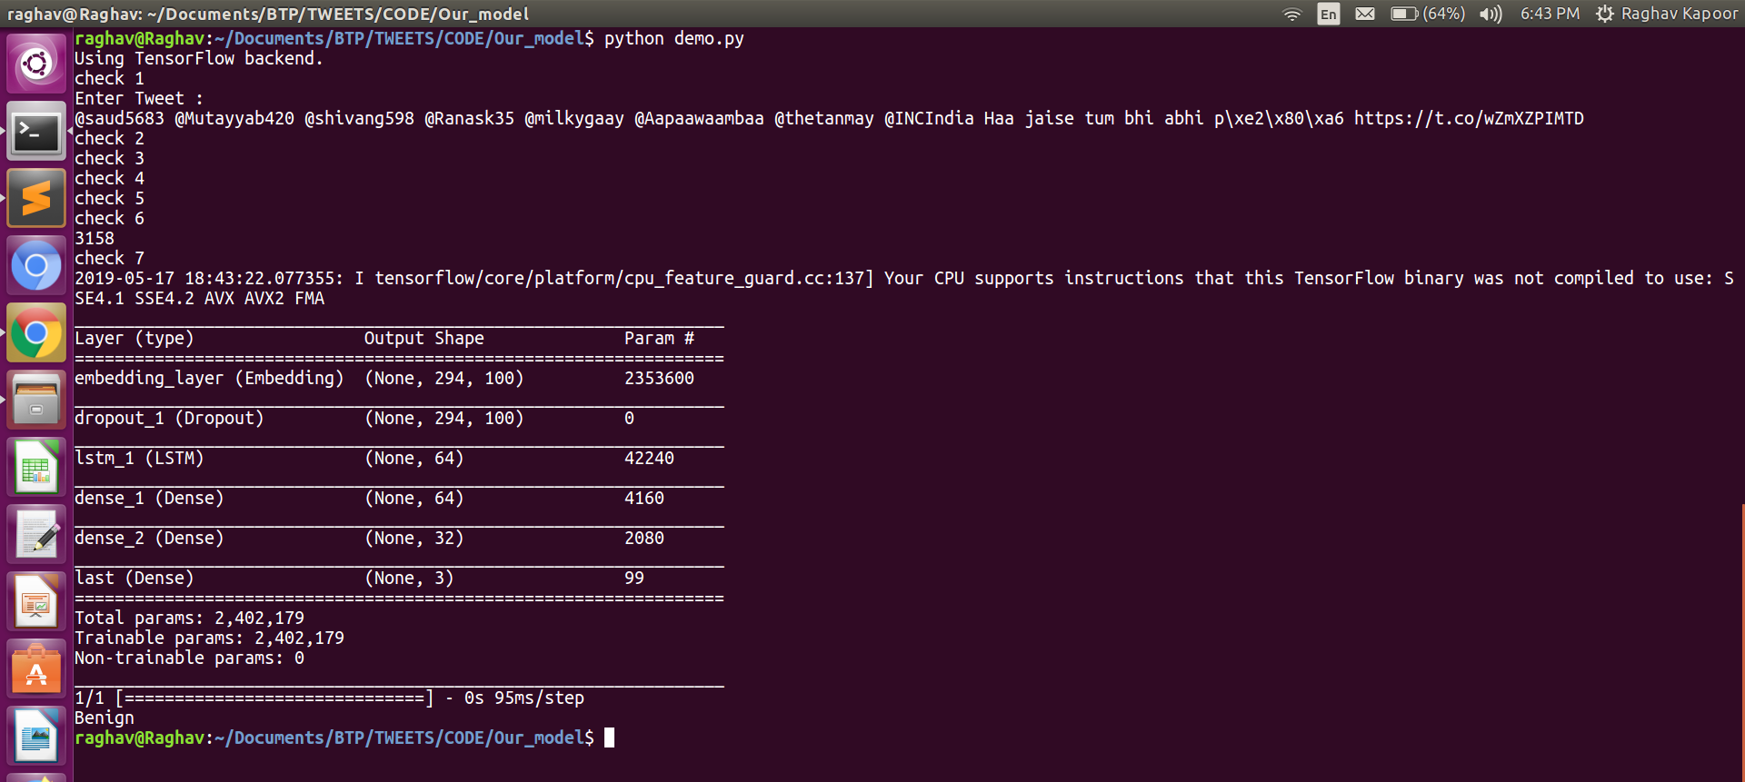
Demo Screenshots
Tweets classification Demo

Slide 38
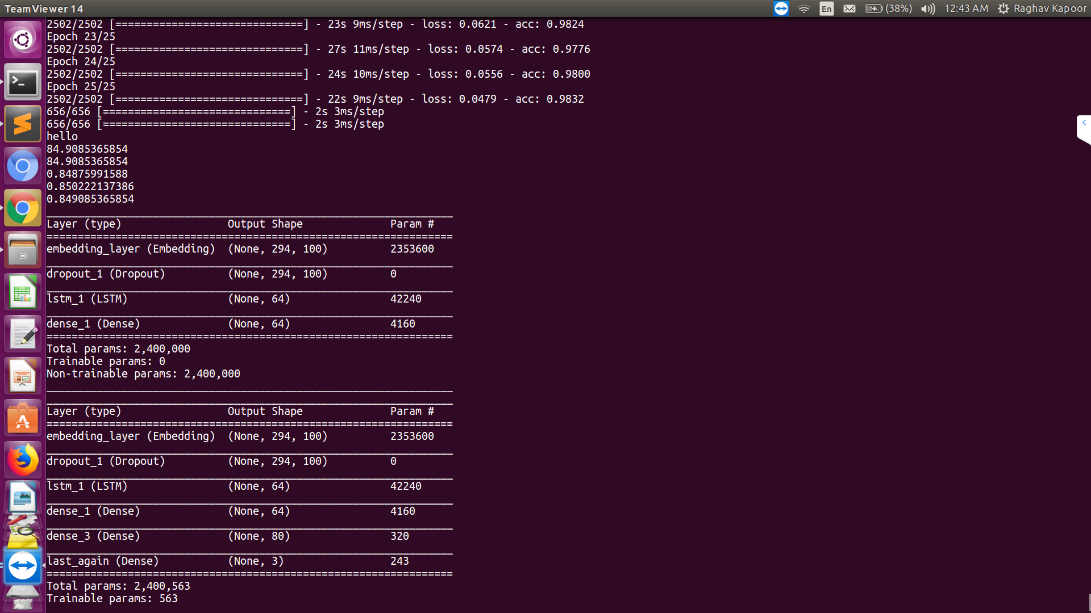
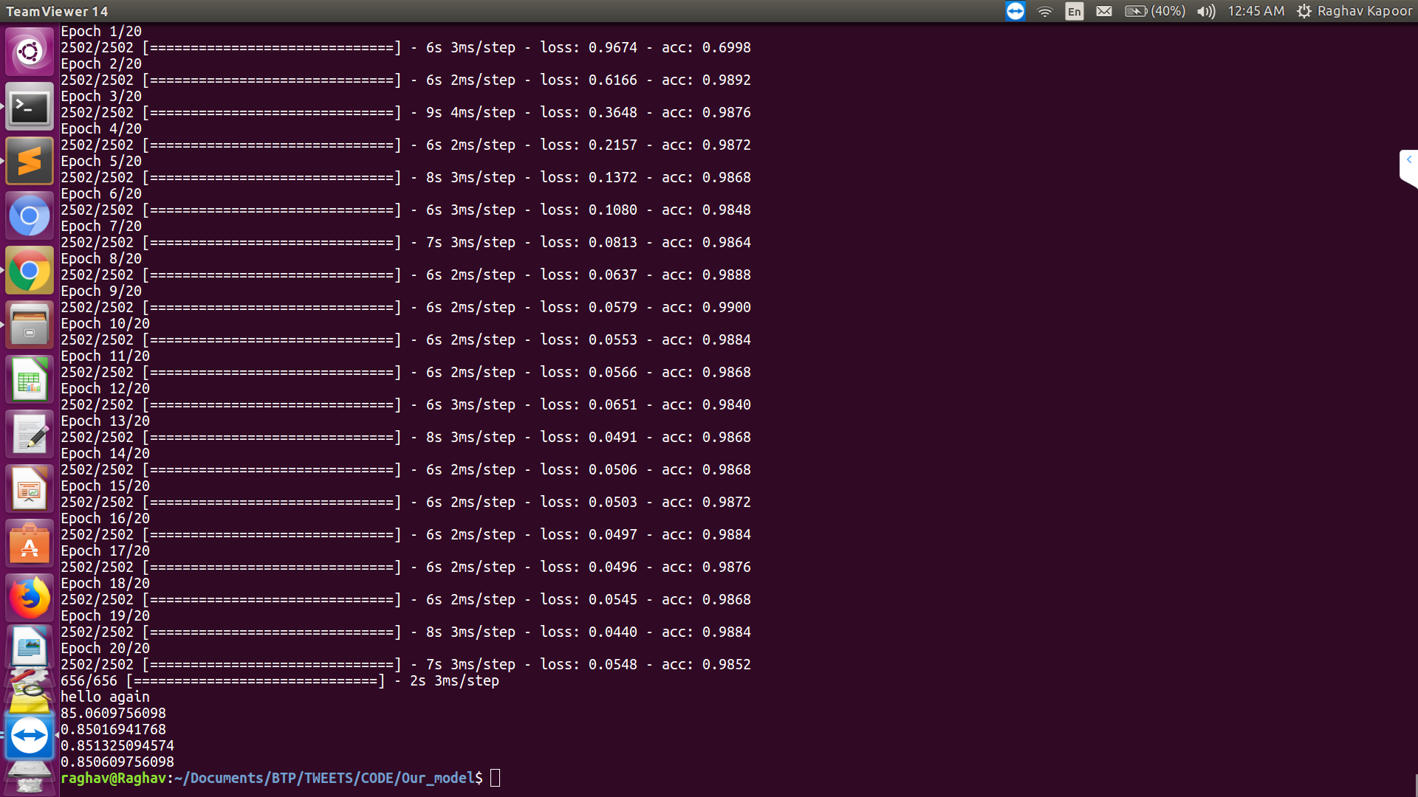
Text Classification Model

Slide 39
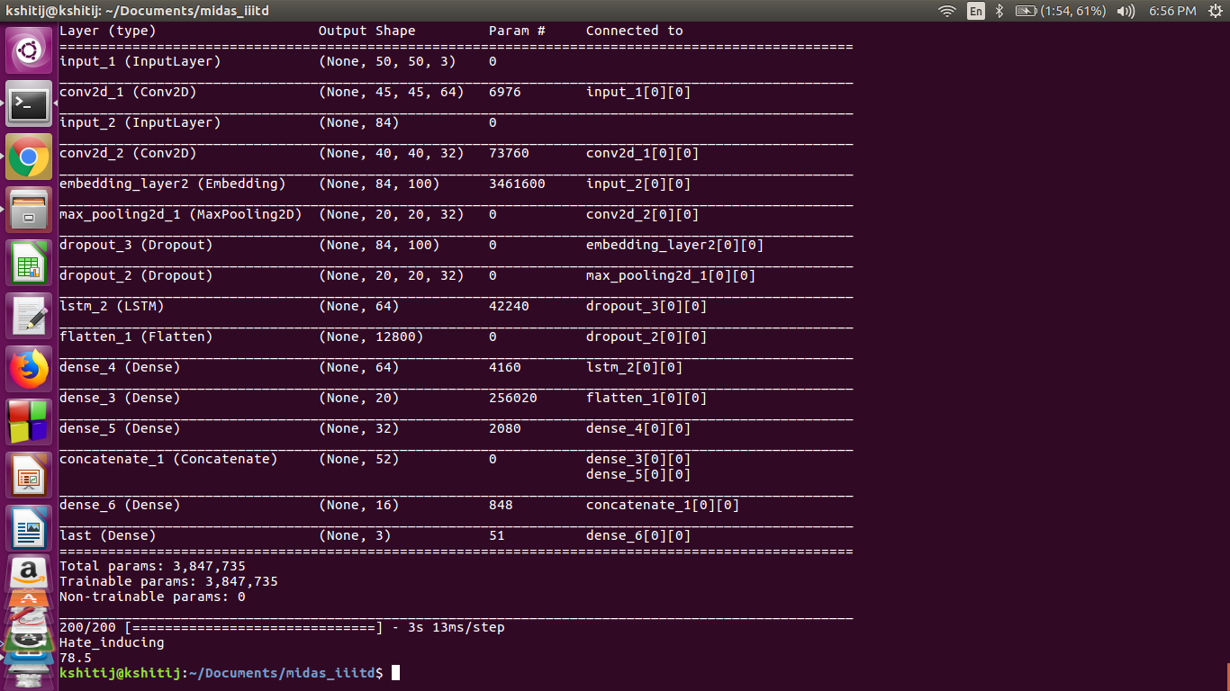
Memes Classification Model and Demo

Slide 40
MORE ABOUT OUR WORK
Link to the Paper:
https://www.aaai.org/Papers/AAAI/2019/SA-KapoorR.211.pdf
Link to Project Video :
https://drive.google.com/file/d/1z_FCuaBQiYRvD6LrV8g4_xr2x5Y57huQ/view?usp=sharing
Link to Award Winning Poster :
https://drive.google.com/file/d/1oGTknE0_sGJVMS9FUk52Nf9ZIzgJQ4cm/view?usp=sharing

Slide 41
REFERENCES
[1] K. Bali, J. Sharma, M. Choudhury, and Y. Vyas, “‘ I am borrowing ya mixing?’ An Analysis of English-Hindi Code Mixing in Facebook,” in Proceedings of the First Workshop on Computational Approaches to Code Switching, 2014, pp. 116–126.
[2] A. Das and B. Gambäck, “Identifying languages at the word level in code-mixed indian social media text,” in Proceedings of the 11th International Conference on Natural Language Processing, 2014, pp. 378–387.
[3] D. Mave, S. Maharjan, and T. Solorio, “Language Identification and Analysis of Code-Switched Social Media Text,” in Proceedings of the Third Workshop on Computational Approaches to Linguistic Code-Switching, 2018, pp. 51–61.
[4] K. Singh, I. Sen, and P. Kumaraguru, “Language identification and named entity recognition in hinglish code mixed tweets,” in Proceedings of ACL 2018, Student Research Workshop, 2018, pp. 52–58.
[5] Y. Vyas, S. Gella, J. Sharma, K. Bali, and M. Choudhury, “Pos tagging of english-hindi code-mixed social media content,” in Proceedings of the 2014 Conference on Empirical Methods in Natural Language Processing (EMNLP), 2014, pp. 974–979.
[6] D. Gupta, S. Tripathi, A. Ekbal, and P. Bhattacharyya, “SMPOST: parts of speech tagger for code-mixed Indic social media text,” arXiv preprint arXiv:1702. 00167, 2017.
[7] P. R. K. Rao and S. L. Devi, “CMEE-IL: Code Mix Entity Extraction in Indian Languages from Social Media Text@ FIRE 2016-An Overview,” in FIRE (Working Notes), 2016, pp. 289–295.
[8] J. Lafferty, A. McCallum, and F. C. N. Pereira, “Conditional random fields: Probabilistic models for segmenting and labeling sequence data,” 2001.

Slide 42
REFERENCES
[9] A. Prabhu, A. Joshi, M. Shrivastava, and V. Varma, “Towards sub-word level compositions for sentiment analysis of hindi-english code mixed text,” arXiv preprint arXiv:1611. 00472, 2016.
[10] S. Wang and C. D. Manning, “Baselines and bigrams: Simple, good sentiment and topic classification,” in Proceedings of the 50th annual meeting of the association for computational linguistics: Short papers-volume 2, 2012, pp. 90–94.
[11] B. Pang, L. Lee, and Others, “Opinion mining and sentiment analysis,” Foundations and Trends® in Information Retrieval, vol. 2, no. 1–2, pp. 1–135, 2008.
[12] S. Sharma, P. Srinivas, and R. C. Balabantaray, “Text normalization of code mix and sentiment analysis,” in 2015 International Conference on Advances in Computing, Communications and Informatics (ICACCI), 2015, pp. 1468–1473.
[13] M. G. Jhanwar and A. Das, “An Ensemble Model for Sentiment Analysis of Hindi-English Code-Mixed Data,” arXiv preprint arXiv:1806.04450, 2018.
[14] D. Gupta, A. Lamba, A. Ekbal, and P. Bhattacharyya, “Opinion Mining in a Code-Mixed Environment: A Case Study with Government Portals,” in Proceedings of the 13th International Conference on Natural Language Processing, 2016, pp. 249–258.
[15] E. Spertus, “Smokey: Automatic recognition of hostile messages,” in Aaai/iaai, 1997, pp. 1058–1065.
[16] D. Yin, Z. Xue, L. Hong, B. D. Davison, A. Kontostathis, and L. Edwards, “Detection of harassment on web 2.0,” Proceedings of the Content Analysis in the WEB, vol. 2, pp. 1–7, 2009.
[17] S. O. Sood, E. F. Churchill, and J. Antin, “Automatic identification of personal insults on social news sites,” J. Am. Soc. Inf. Sci. Technol., vol. 63, no. 2, pp. 270–285, 2012.

Slide 43
REFERENCES
[18] G. Xiang, B. Fan, L. Wang, J. Hong, and C. Rose, “Detecting offensive tweets via topical feature discovery over a large scale twitter corpus,” in Proceedings of the 21st ACM international conference on Information and knowledge management, 2012, pp. 1980–1984.
[19] F. Del Vigna12, A. Cimino23, F. Dell’Orletta, M. Petrocchi, and M. Tesconi, “Hate me, hate me not: Hate speech detection on Facebook,” 2017.
[20] A. Bohra, D. Vijay, V. Singh, S. S. Akhtar, and M. Shrivastava, “A Dataset of Hindi-English Code-Mixed Social Media Text for Hate Speech Detection,” in Proceedings of the Second Workshop on Computational Modeling of People’s Opinions, Personality, and Emotions in Social Media, 2018, pp. 36–41.
[21] P. Mathur, R. Shah, R. Sawhney, and D. Mahata, “Detecting offensive tweets in hindi-english code-switched language,” in Proceedings of the Sixth International Workshop on Natural Language Processing for Social Media, 2018, pp. 18–26.
[22] P. Mathur, R. Sawhney, M. Ayyar, and R. Shah, “Did you offend me? classification of offensive tweets in hinglish language,” in Proceedings of the 2nd Workshop on Abusive Language Online (ALW2), 2018, pp. 138–148.
[23] W. Wei-ning, Y. Ying-lin, and J. Sheng-ming, “Image retrieval by emotional semantics: A study of emotional space and feature extraction,” in 2006 IEEE International Conference on Systems, Man and Cybernetics, 2006, vol. 4, pp. 3534–3539.
[24] S. Siersdorfer, E. Minack, F. Deng, and J. Hare, “Analyzing and predicting sentiment of images on the social web,” in Proceedings of the 18th ACM international conference on Multimedia, 2010, pp. 715–718.
[25] A. Krizhevsky, I. Sutskever, and G. E. Hinton, “Imagenet classification with deep convolutional neural networks,” in Advances in neural information processing systems, 2012, pp. 1097–1105.

Slide 44
REFERENCES
[26] Q. You, J. Luo, H. Jin, and J. Yang, “Robust image sentiment analysis using progressively trained and domain transferred deep networks,” in Twenty-Ninth AAAI Conference on Artificial Intelligence, 2015.
[27] G. Cai and B. Xia, “Convolutional neural networks for multimedia sentiment analysis,” in Natural Language Processing and Chinese Computing, Springer, 2015, pp. 159–167.
[28] S. Poria, I. Chaturvedi, E. Cambria, and A. Hussain, “Convolutional MKL based multimodal emotion recognition and sentiment analysis,” in 2016 IEEE 16th international conference on data mining (ICDM), 2016, pp. 439–448.
[29] L.-P. Morency, R. Mihalcea, and P. Doshi, “Towards multimodal sentiment analysis: Harvesting opinions from the web,” in Proceedings of the 13th international conference on multimodal interfaces, 2011, pp. 169–176.
[30] R. Kapoor, Y. Kumar, K. Rajput, R. R. Shah, P. Kumaraguru, and R. Zimmermann, “Mind Your Language: Abuse and Offense Detection for Code-Switched Languages,” arXiv preprint arXiv:1809. 08652, 2018.
[31] T. Davidson, D. Warmsley, M. Macy, and I. Weber, “Automated hate speech detection and the problem of offensive language,” in Eleventh International AAAI Conference on Web and Social Media, 2017.
[32] J. Cohen, “A coefficient of agreement for nominal scales,” Educ. Psychol. Meas., vol. 20, no. 1, pp. 37–46, 1960.
[33] R. Barnett et al., “The LIDES Coding Manual: A Document for Preparing and Analyzing Language Interaction Data Version 1.1--July 1999,” International Journal of Bilingualism, vol. 4, no. 2, pp. 131–271, 2000.
[34] J. L. Fleiss, “Measuring nominal scale agreement among many raters,” Psychol. Bull., vol. 76, no. 5, p. 378, 1971.

Slide 45
REFERENCES
[35] J. Pennington, R. Socher, and C. Manning, “Glove: Global vectors for word representation,” in Proceedings of the 2014 conference on empirical methods in natural language processing (EMNLP), 2014, pp. 1532–1543.
[36] F. Godin, B. Vandersmissen, W. De Neve, and R. Van de Walle, “Multimedia Lab @ ACL WNUT NER Shared Task: Named Entity Recognition for Twitter Microposts using Distributed Word Representations,” in Proceedings of the Workshop on Noisy User-generated Text, 2015, pp. 146–153.
[37] G. Bradski and A. Kaehler, Learning OpenCV: Computer vision with the OpenCV library. “ O’Reilly Media, Inc.,” 2008.
[38] C. Stauffer and W. E. L. Grimson, “Adaptive background mixture models for real-time tracking,” in Proceedings. 1999 IEEE Computer Society Conference on Computer Vision and Pattern Recognition (Cat. No PR00149), 1999, vol. 2, pp. 246–252.
[39] P. Bojanowski, E. Grave, A. Joulin, and T. Mikolov, “Enriching word vectors with subword information,” Transactions of the Association for Computational Linguistics, vol. 5, pp. 135–146, 2017.
[40] J. Devlin, M.-W. Chang, K. Lee, and K. Toutanova, “Bert: Pre-training of deep bidirectional transformers for language understanding,” arXiv preprint arXiv:1810. 04805, 2018.
[41] D. A. Van Dyk and X.-L. Meng, “The art of data augmentation,” J. Comput. Graph. Stat., vol. 10, no. 1, pp. 1–50, 2001.
[42] V. Nair and G. E. Hinton, “Rectified linear units improve restricted boltzmann machines,” in Proceedings of the 27th international conference on machine learning (ICML-10), 2010, pp. 807–814.
[43] D. P. Kingma and J. Ba, “Adam: A method for stochastic optimization,” arXiv preprint arXiv:1412. 6980, 2014.

Slide 46
THANK YOU

